Slide 1
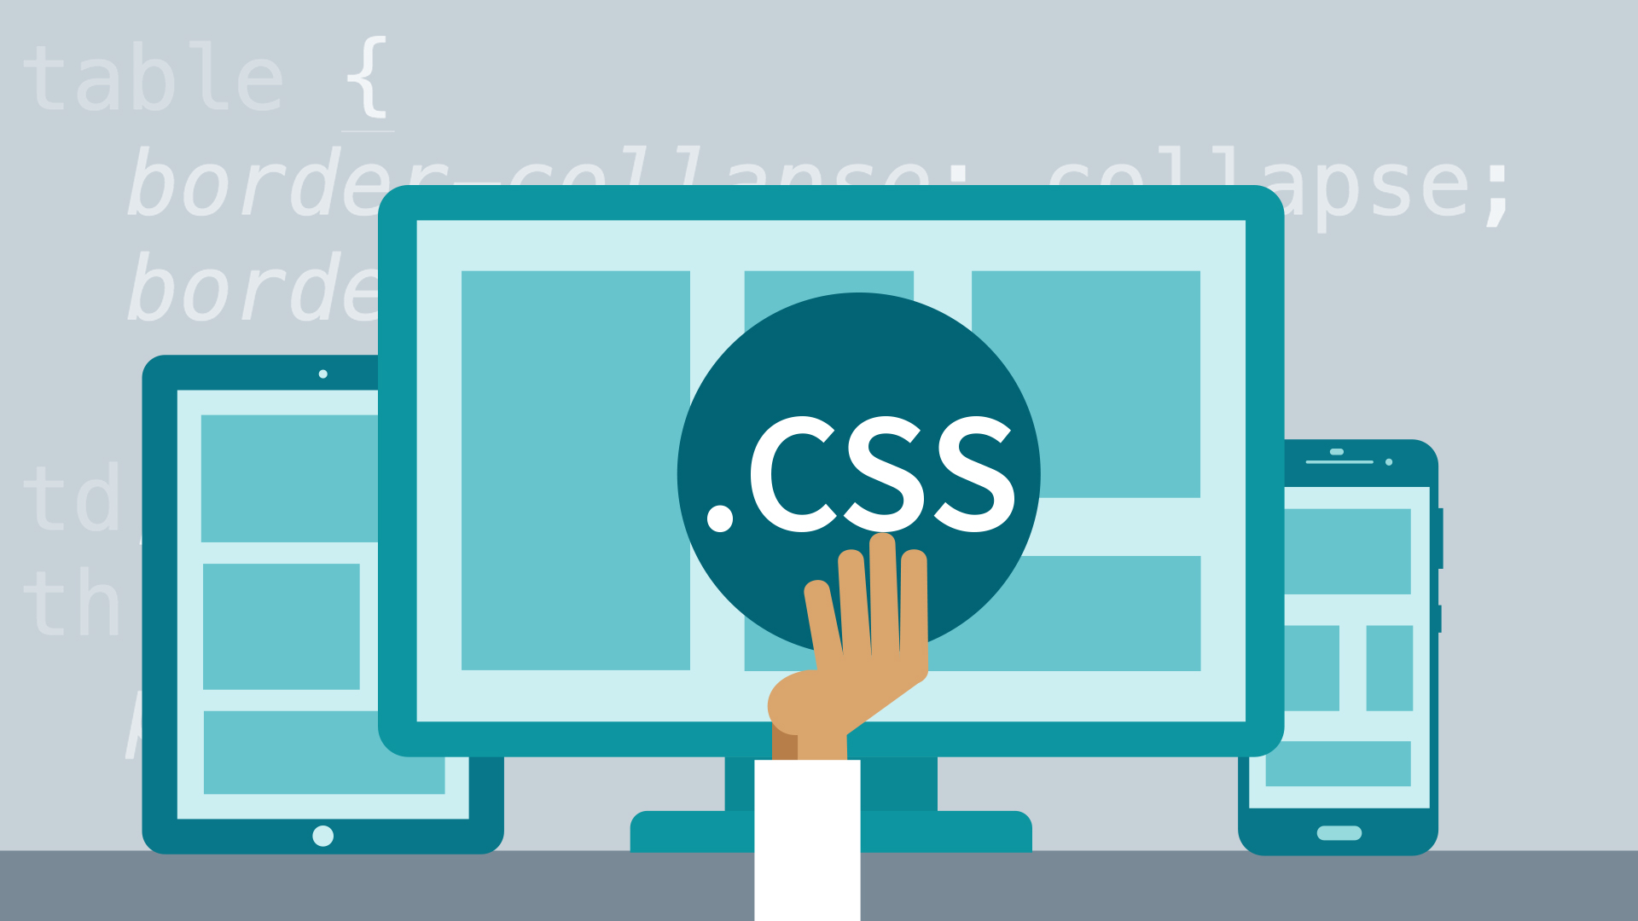

Slide 2
Why To learn CSS
Styling the TML Tags
Responsive Website
Animation On website
2D and 3D Transformation Of HTML Elements
CSS Makes Website Development Process Fast

Slide 3


Slide 4


Slide 5
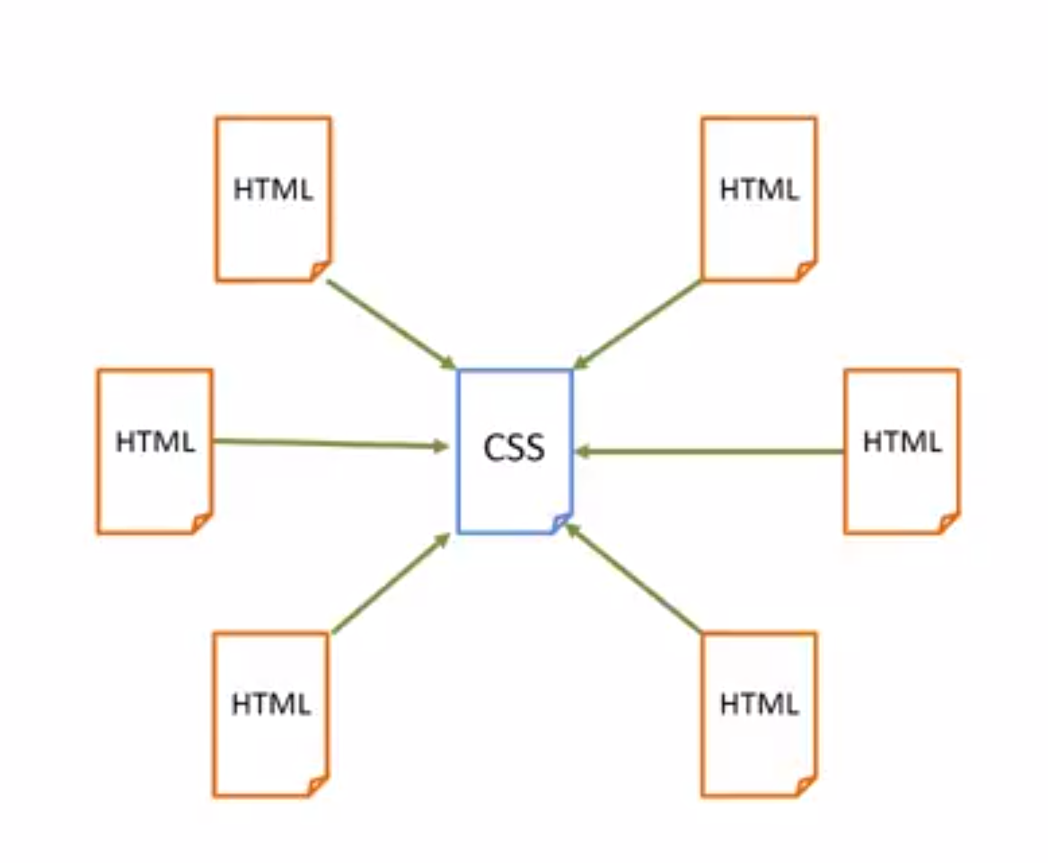

Slide 6
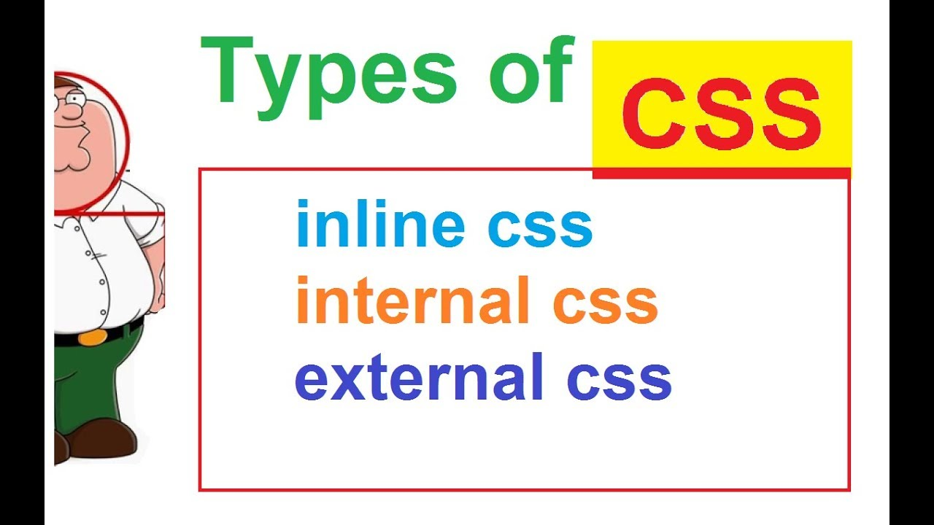

Slide 7
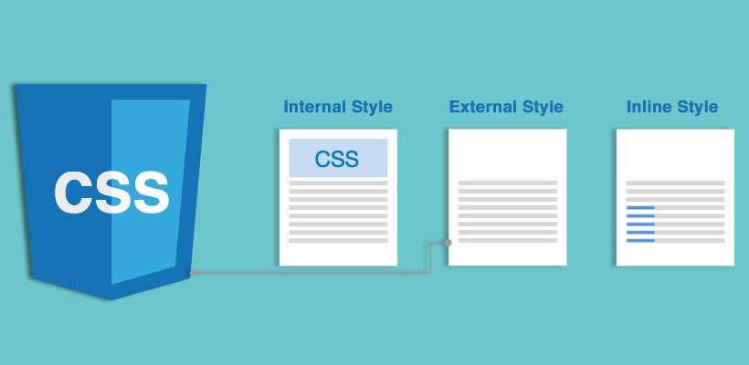

Slide 8
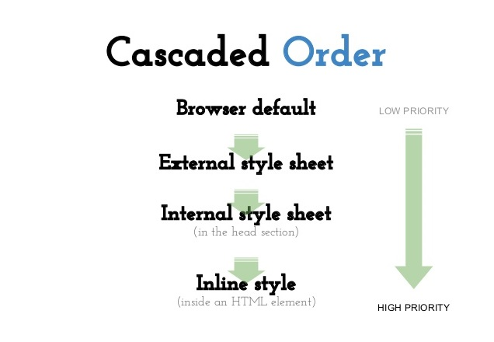

Slide 9
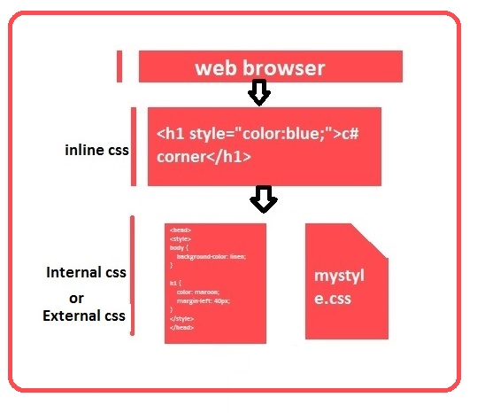

Slide 10
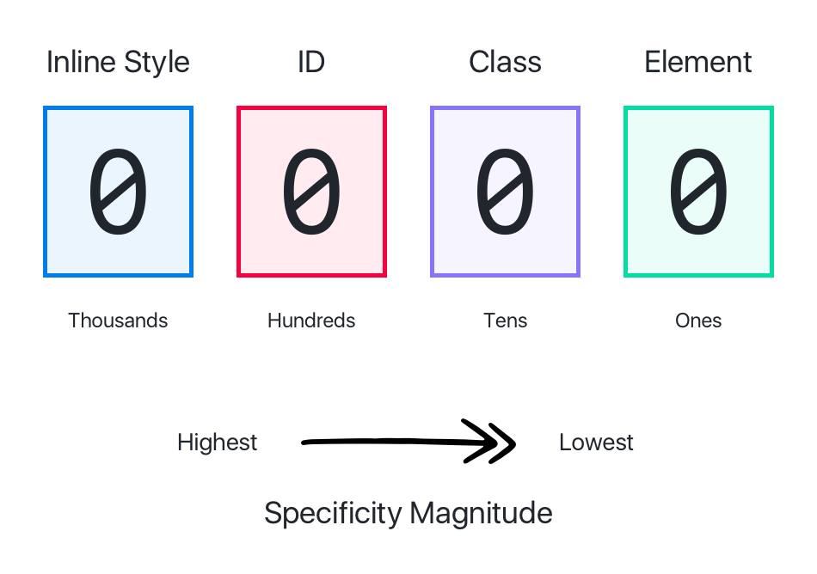

Slide 11
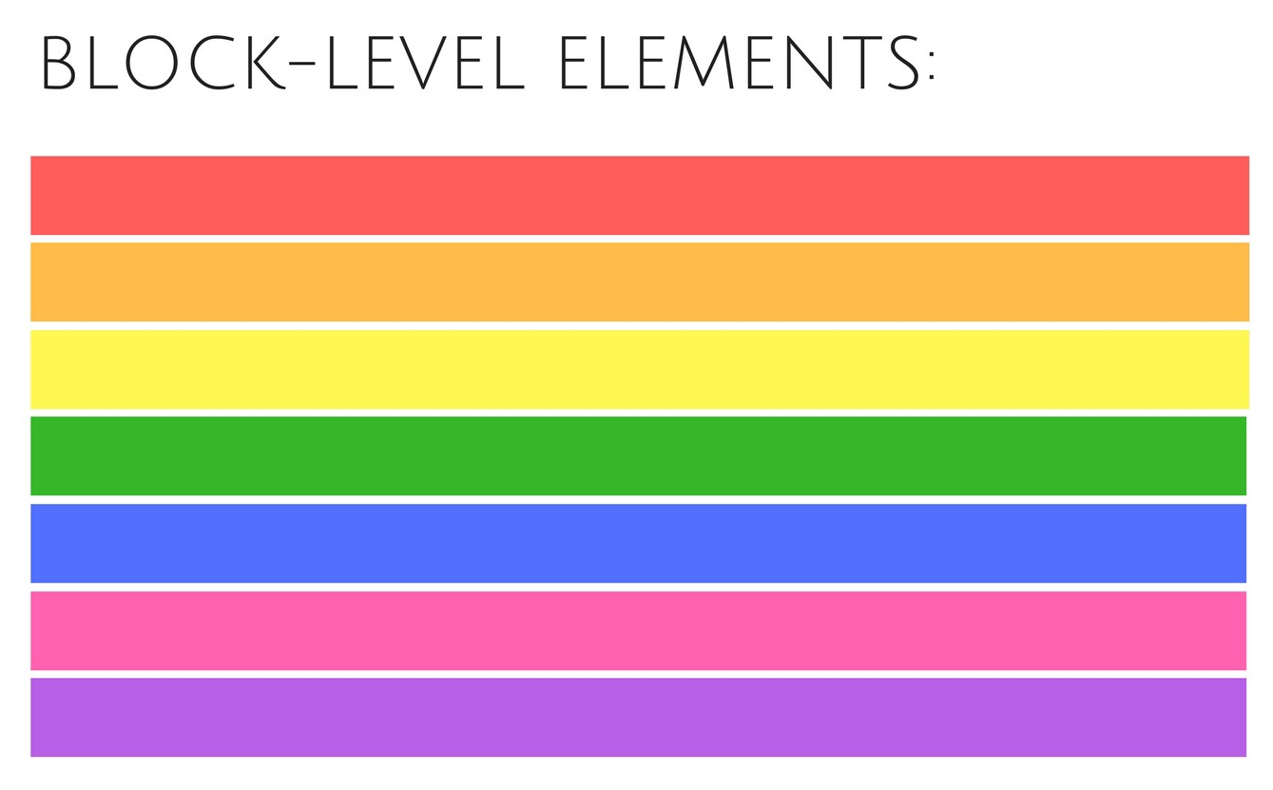

Slide 12
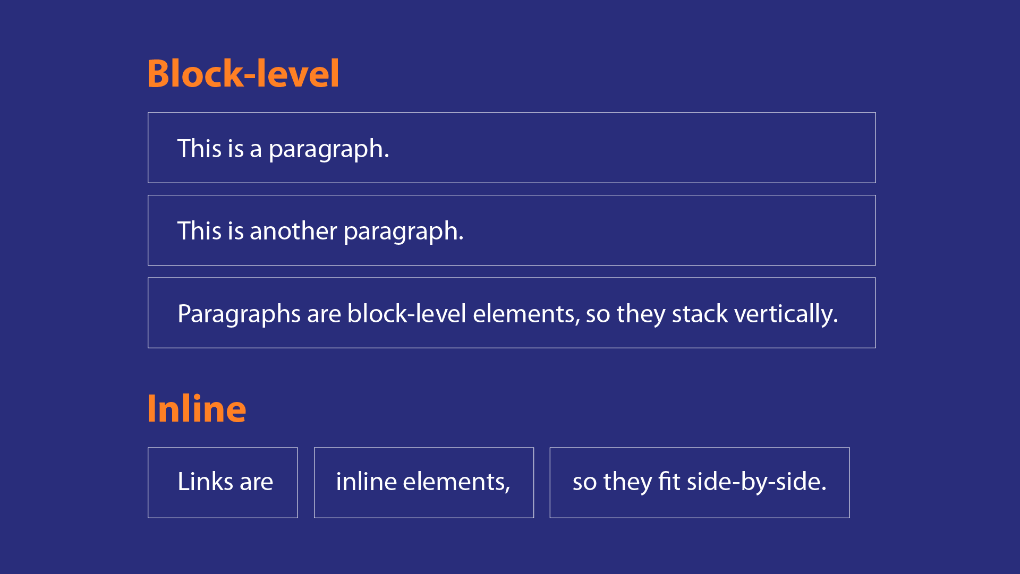

Slide 13


Slide 14
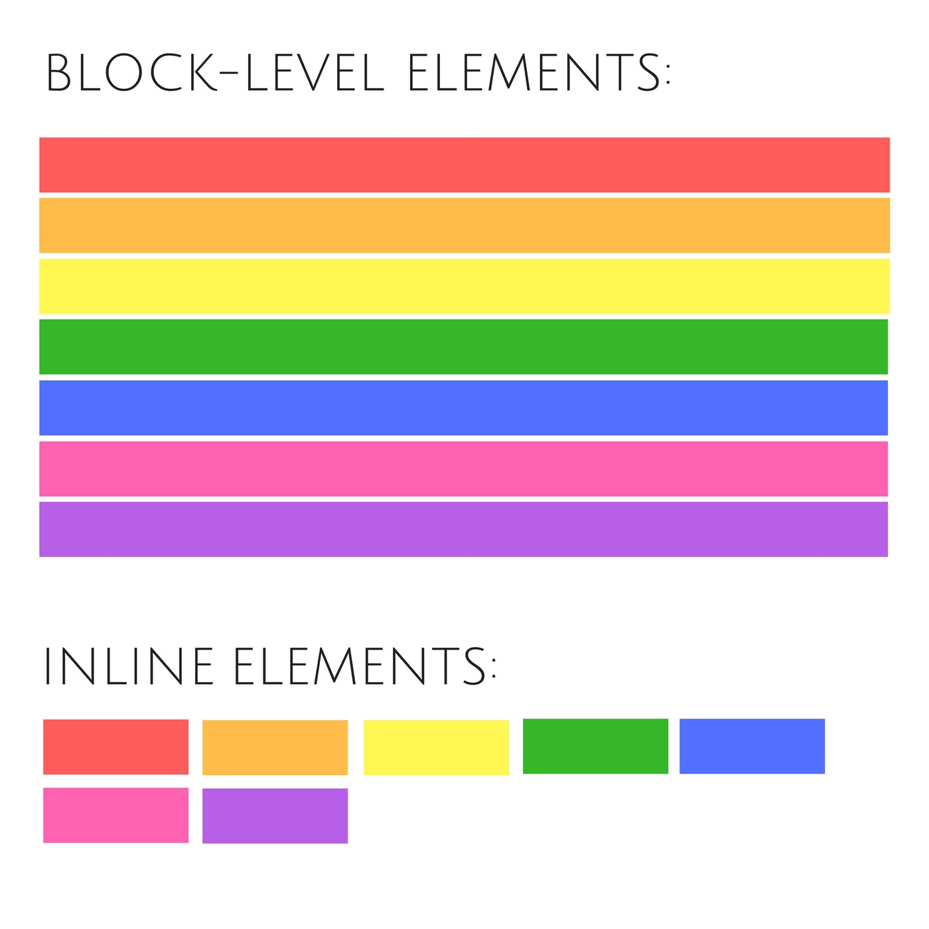

Slide 15
